Slide 1
Shading I
Ed Angel
Professor of Computer Science, Electrical and Computer Engineering, and Media Arts
University of New Mexico

Slide 2
Objectives
Learn to shade objects so their images appear three-dimensional
Introduce the types of light-material interactions
Build a simple reflection model---the Phong model--- that can be used with real time graphics hardware

Slide 3
Why we need shading
Suppose we build a model of a sphere using many polygons and color it with glColor. We get something like
But we want

Slide 4
Shading
Why does the image of a real sphere look like
Light-material interactions cause each point to have a different color or shade
Need to consider
Light sources
Material properties
Location of viewer
Surface orientation

Slide 5
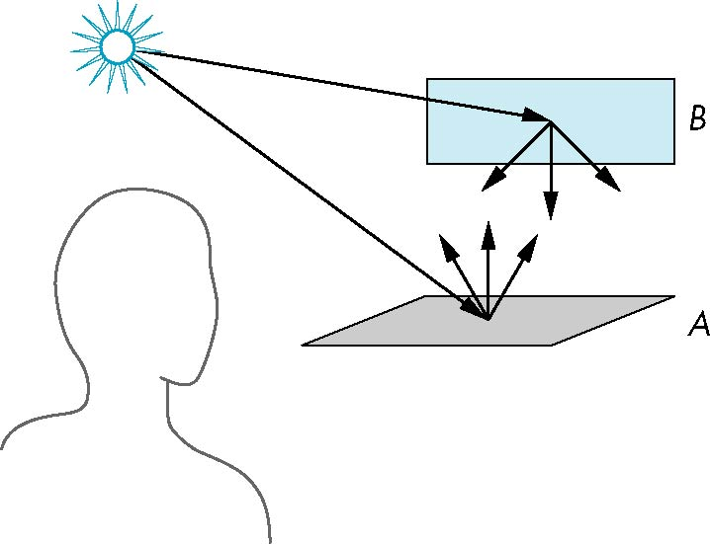
Scattering
Light strikes A
Some scattered
Some absorbed
Some of scattered light strikes B
Some scattered
Some absorbed
Some of this scattered
light strikes A
and so on

Slide 6
Rendering Equation
The infinite scattering and absorption of light can be described by the rendering equation
Cannot be solved in general
Ray tracing is a special case for perfectly reflecting surfaces
Rendering equation is global and includes
Shadows
Multiple scattering from object to object

Slide 7
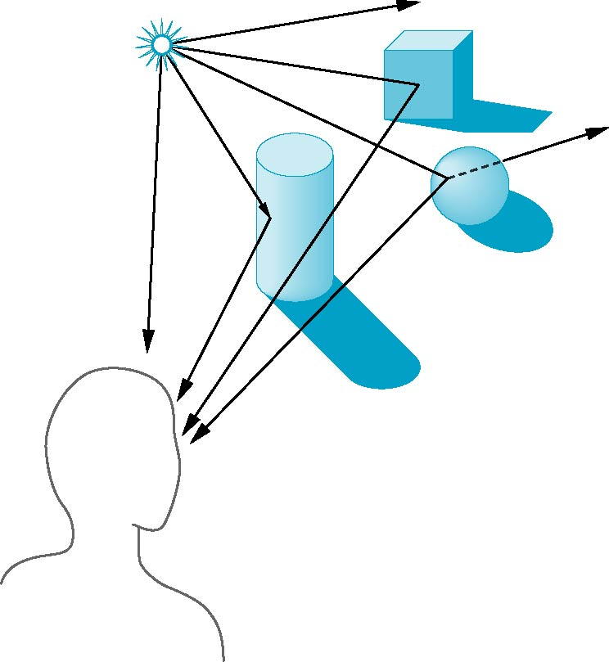
Global Effects
shadow
multiple reflection
translucent surface

Slide 8
Local vs Global Rendering
Correct shading requires a global calculation involving all objects and light sources
Incompatible with pipeline model which shades each polygon independently (local rendering)
However, in computer graphics, especially real time graphics, we are happy if things “look right”
Exist many techniques for approximating global effects

Slide 9
Light-Material Interaction
Light that strikes an object is partially absorbed and partially scattered (reflected)
The amount reflected determines the color and brightness of the object
A surface appears red under white light because the red component of the light is reflected and the rest is absorbed
The reflected light is scattered in a manner that depends on the smoothness and orientation of the surface

Slide 10
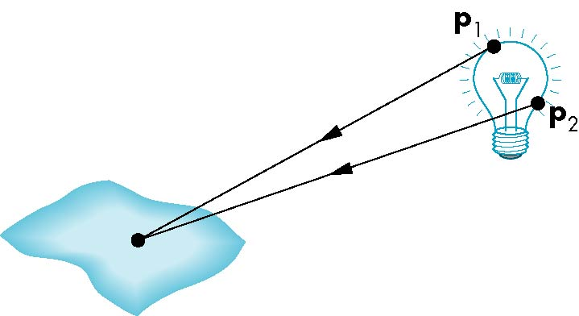
Light Sources
General light sources are difficult to work with because we must integrate light coming from all points on the source

Slide 11
Simple Light Sources
Point source
Model with position and color specified by a point
Distant source = infinite distance away (parallel)
Specified by a vector
Spotlight
Restrict light from ideal point source
Ambient light
Same amount of light everywhere in scene
Can model contribution of many sources and reflecting surfaces

Slide 12

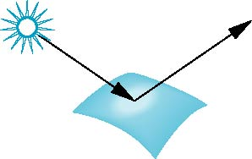
Surface Types
The smoother a surface, the more reflected light is concentrated in the direction a perfect mirror would reflected the light
A very rough surface scatters light in all directions
smooth surface
rough surface

Slide 13
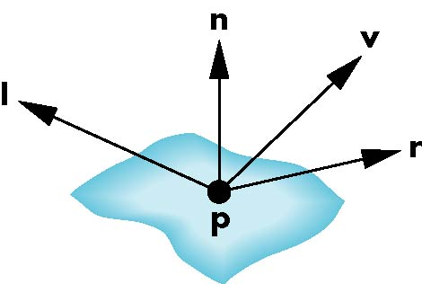
Phong Model
A simple model that can be computed rapidly
Has three components
Diffuse
Specular
Ambient
Uses four vectors
To source
To viewer
Normal
Perfect reflector

Slide 14
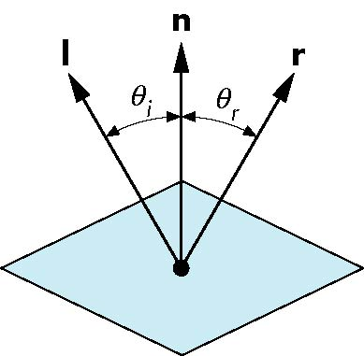
Ideal Reflector
Normal is determined by local orientation
Angle of incidence = angle of relection
The three vectors must be coplanar
r = 2 (l · n ) n - l

Slide 15
Lambertian Surface
Perfectly diffuse reflector
Light scattered equally in all directions
Amount of light reflected is proportional to the vertical component of incoming light
reflected light ~cos θ_{i}
cos θ_{i} = l · n if vectors normalized
There are also three coefficients, k_{r}, k_{b}, k_{g} that show how much of each color component is reflected

Slide 16

Specular Surfaces
Most surfaces are neither ideal diffusers nor perfectly specular (ideal reflectors)
Smooth surfaces show specular highlights due to incoming light being reflected in directions concentrated close to the direction of a perfect reflection
specular
highlight

Slide 17
Modeling Specular Relections
Phong proposed using a term that dropped off as the angle between the viewer and the ideal reflection increased
I_{r} ~ k_{s} I cos^{α}φ
φ
reflected
intensity
shininess coef
incoming intensity
absorption coef

Slide 18
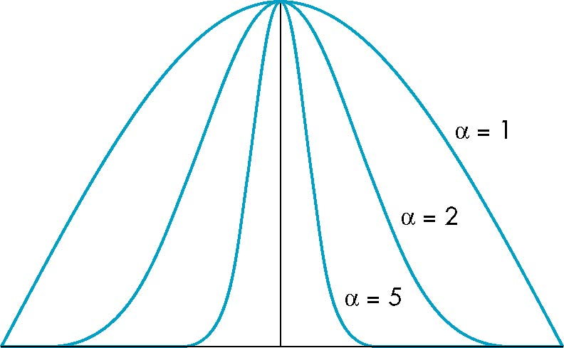
The Shininess Coefficient
Values of α between 100 and 200 correspond to metals
Values between 5 and 10 give surface that look like plastic
cos^{α} φ
-90
φ
90

